Slide 1


2nd Meeting - T3/2021
By,
D2i Geelong Squad

Slide 2


Machine Learning
Tree Problem
A two-part exercise that incorporates visualization related to trees at a suburb and tree type level and other relevant metrics, with prediction of tree on the basis of its features in Greater city of Geelong
Pedestrian Problem
To keep a track of citizen in Geelong city and types of places they have been to. This keeps track of citizen movement in restaurants, hospitals etc. in post lockdown time in the city. We use Google API to get this information and monitor movement.
Fire Problem
Bushfires are an inconsistent hazard in Geelong City, but it does create havoc when it affect the city. With high-risk fire regions as close as 80km from Geelong, it is important to predict the possibility of fire in each Geelong and nearby suburb. Use time series prediction algorithms like LSTM, GRU and boosting algorithms
Wi-Fi Problem
With variable foot count in and around important hubs in Geelong City where free Wi-Fi is provided, it is important to know the foot count of users to increase/decrease router bandwidth or count as per usage. We plan to incorporate time series prediction exercises and MLP techniques for this task and check performance.

Slide 3
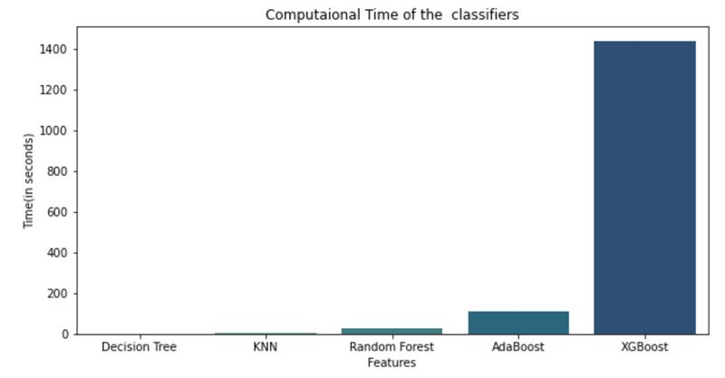
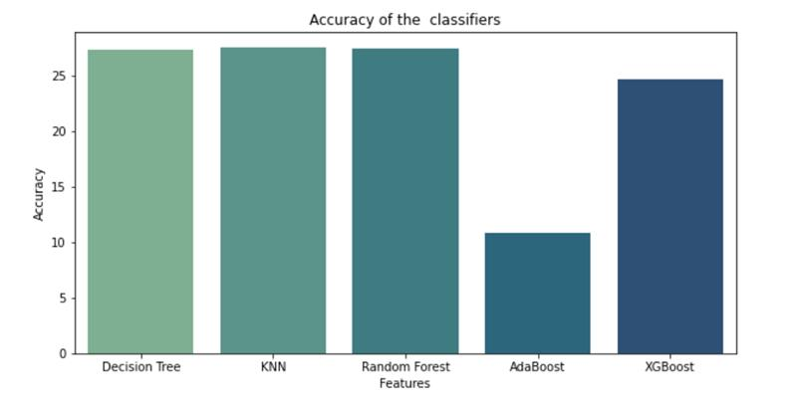
Work done on Tree Problem
Incorporated data cleaning and data wrangling steps including Null Handling, Feature set changes and outlier handling.
Models used are Random Forest, Decision Tree, Nearest Neighbors, Adaboost and XGBoost
Tuning of the parameters
Training/ Evaluation of the Models
Selecting the most appropriate model

Slide 4
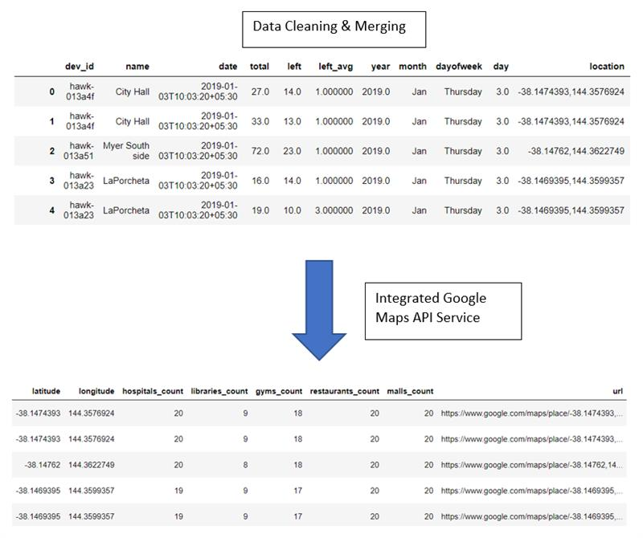
Work done on Pedestrian Problem
Data sets provided by the client
Data exploration, data cleaning & data Merging
Integrated google maps API service.
Pedestrian monitoring
Fetched the count of particular type of buildings
Mapped the location of each devices on google maps using their respective coordinates

Slide 5
Fire Problem
Work Completed
Extracted old sample and worked on data merge code and data cleaning code
Data imbalance and Feature Engineering steps identified
Problem modified to include regions to a certain radius in Kilometers around Geelong city
Work In-Progress
Current Data to be extracted and date-till to be finalized
Sequential Input to Supervised input conversion to be implemented
LSTM, GRU and Boosting Algorithms to be tuned, tested and final model to be identified
Results to be shared with the Data Visualization team
Wi-Fi Problem
Work Completed
Recent data extracted and cleaned
Clustering exercise is close to completion and business decisions to be finalized to identify new class column to be used for classification problem
Target Variable and Feature set identified
Work In-Progress
Classes to be finalized after clustering exercise
Current Data to be extracted and date-till to be finalized
Data Conversion and modeling pieces identical to Fire Problem
Results to be shared with the Data Visualization team

Slide 6

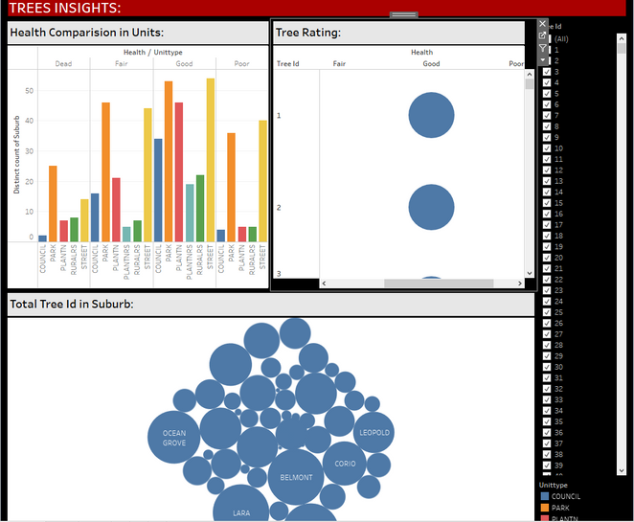
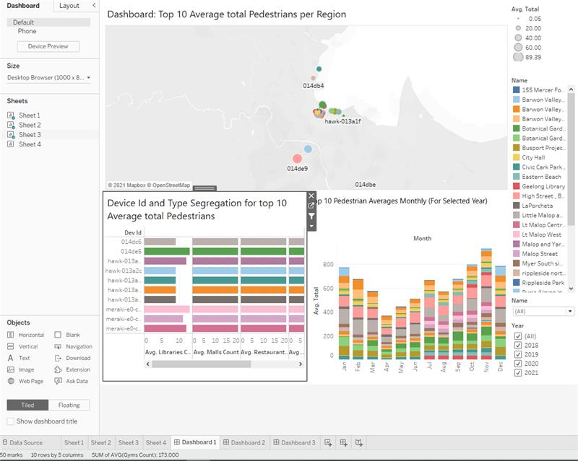

Data Visualization
Work on Trees and Pedestrians Dashboards by showcasing their key metrics.
In Trees problem, displaying multiple charts such as Bar chart which indicates distinct count of 'tree id' to 'health / unit type' & which shows distinct count of total 'tree id' to 'suburbs'.
Establishing clear relationships between the metrics from Tree & Pedestrian problem.
Exhibiting various metrics on Geelong map using date, year and time filters and functions.

Slide 7
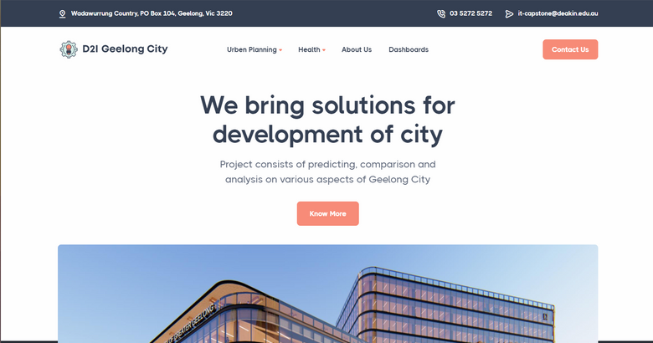
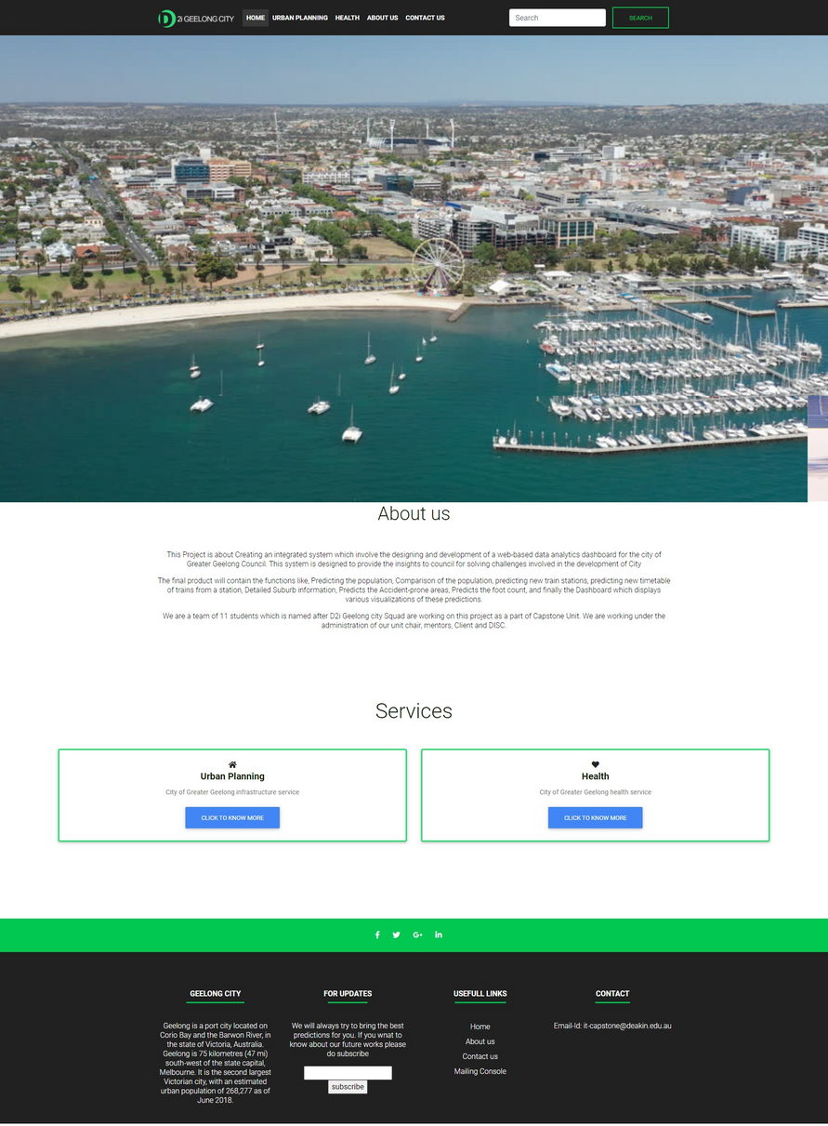
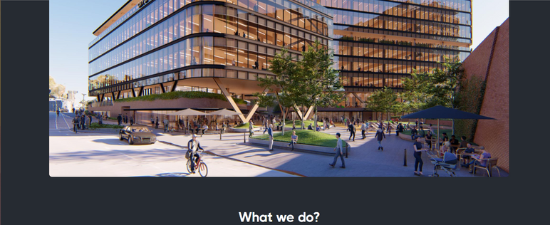

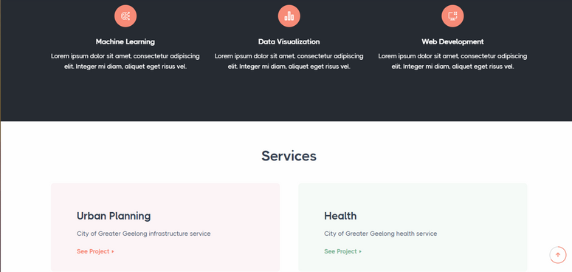
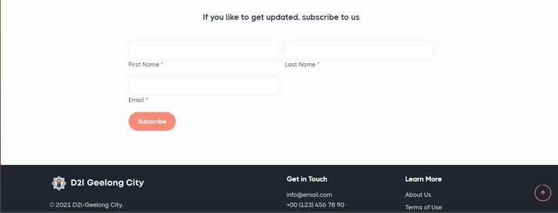
Web Development
After
Before
Demo

Slide 8


Thank you!

